Slide 1
Computer graphics III – Into
Jaroslav Křivánek
Charles University in Prague & Render Legion, a.s.

Slide 2
RENDERING

Slide 3
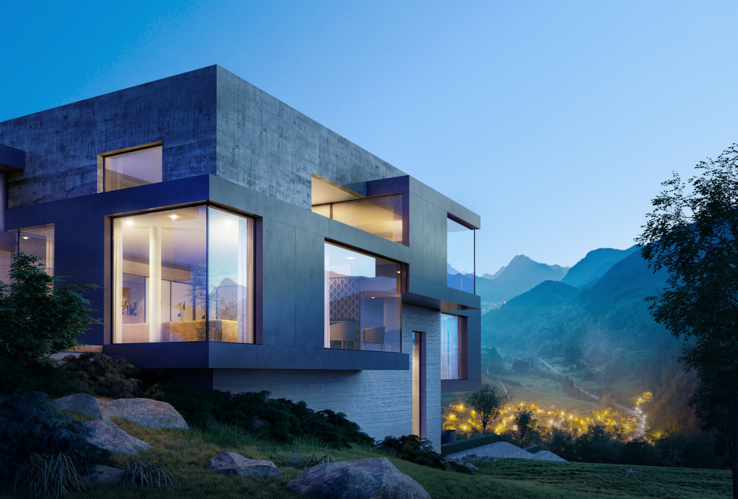

| Image by Divi Studio |
divistudio.com

Slide 4
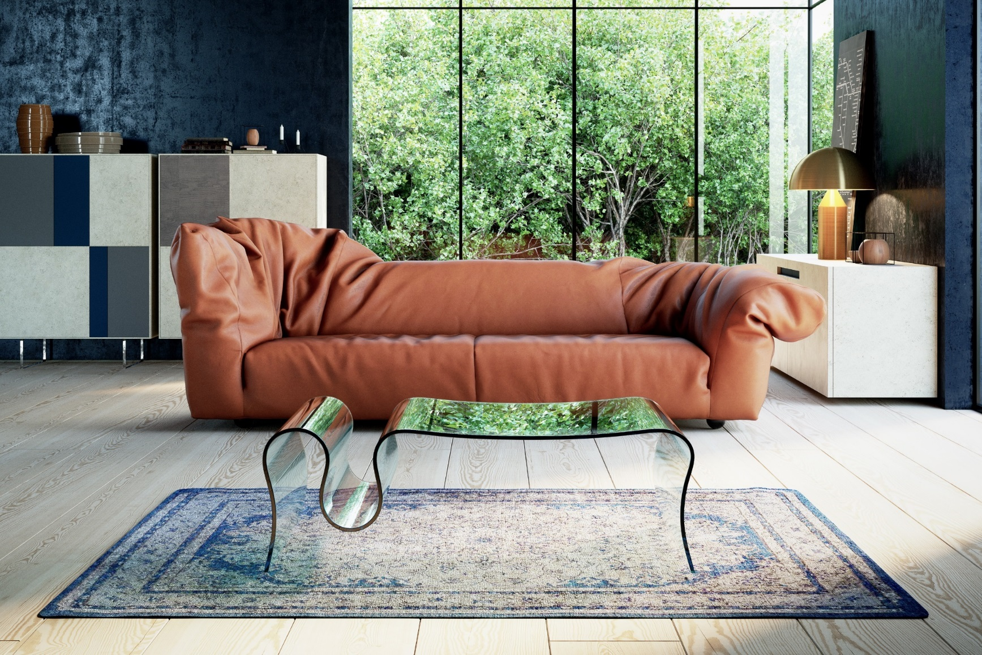
| Image by Jan Kudelasek |
allcity,cz

Slide 5



Slide 6
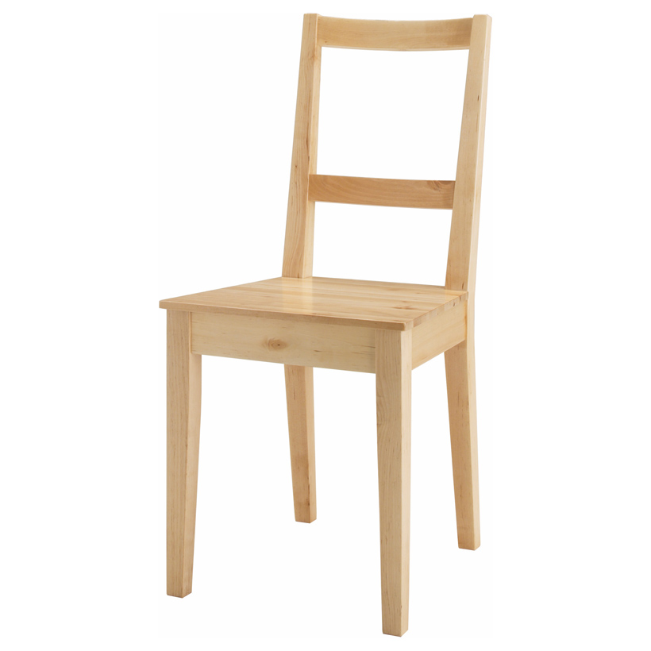
Chair “Bertil”, 2006

Slide 7
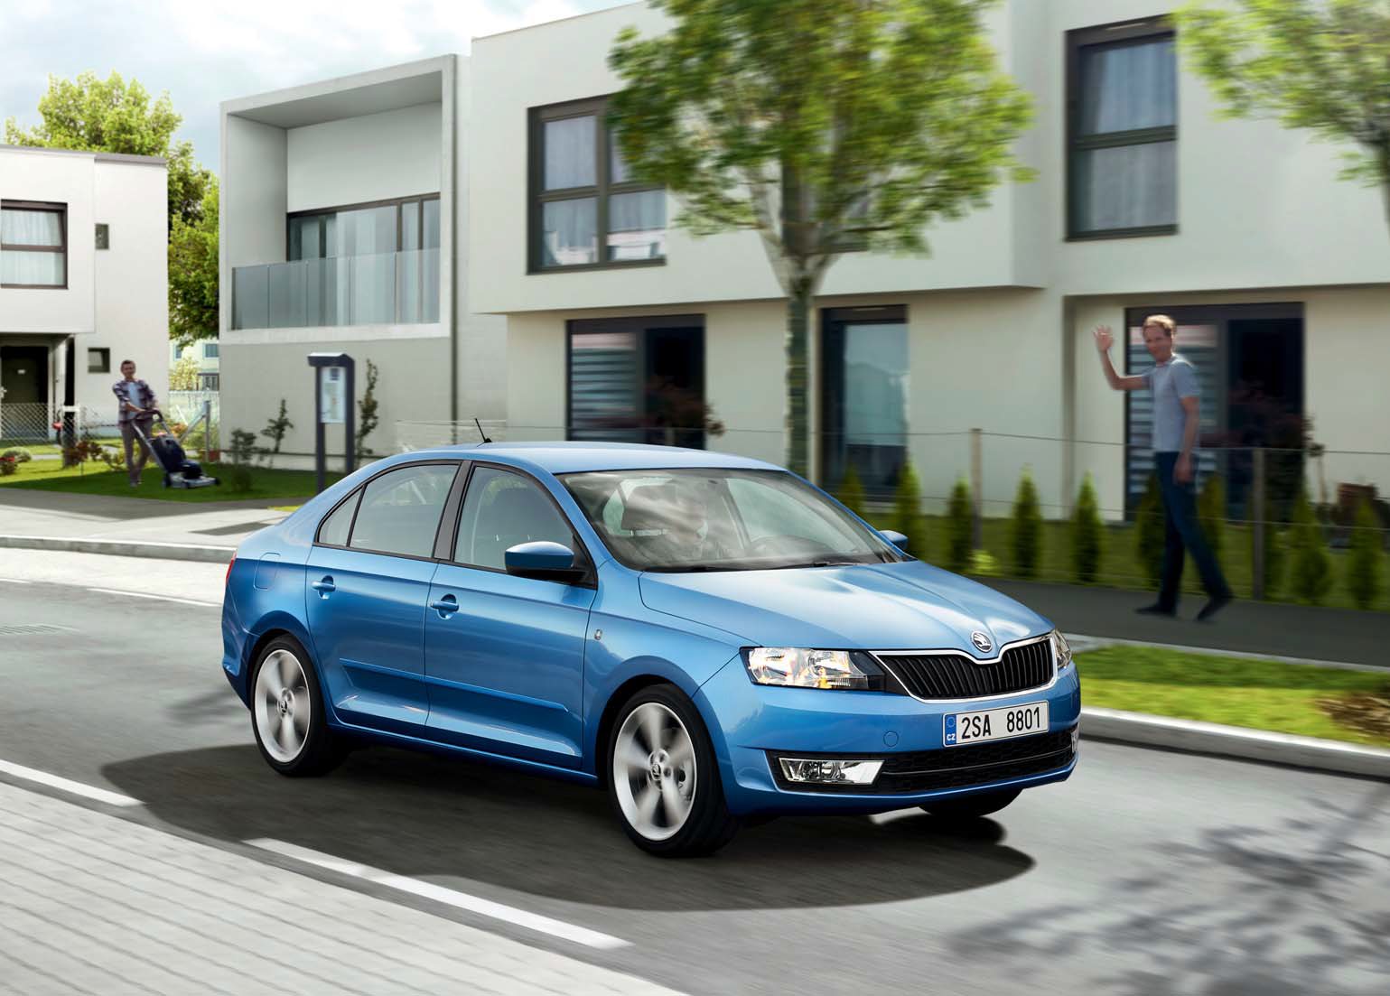
ŠKODA Catalogue

Slide 8
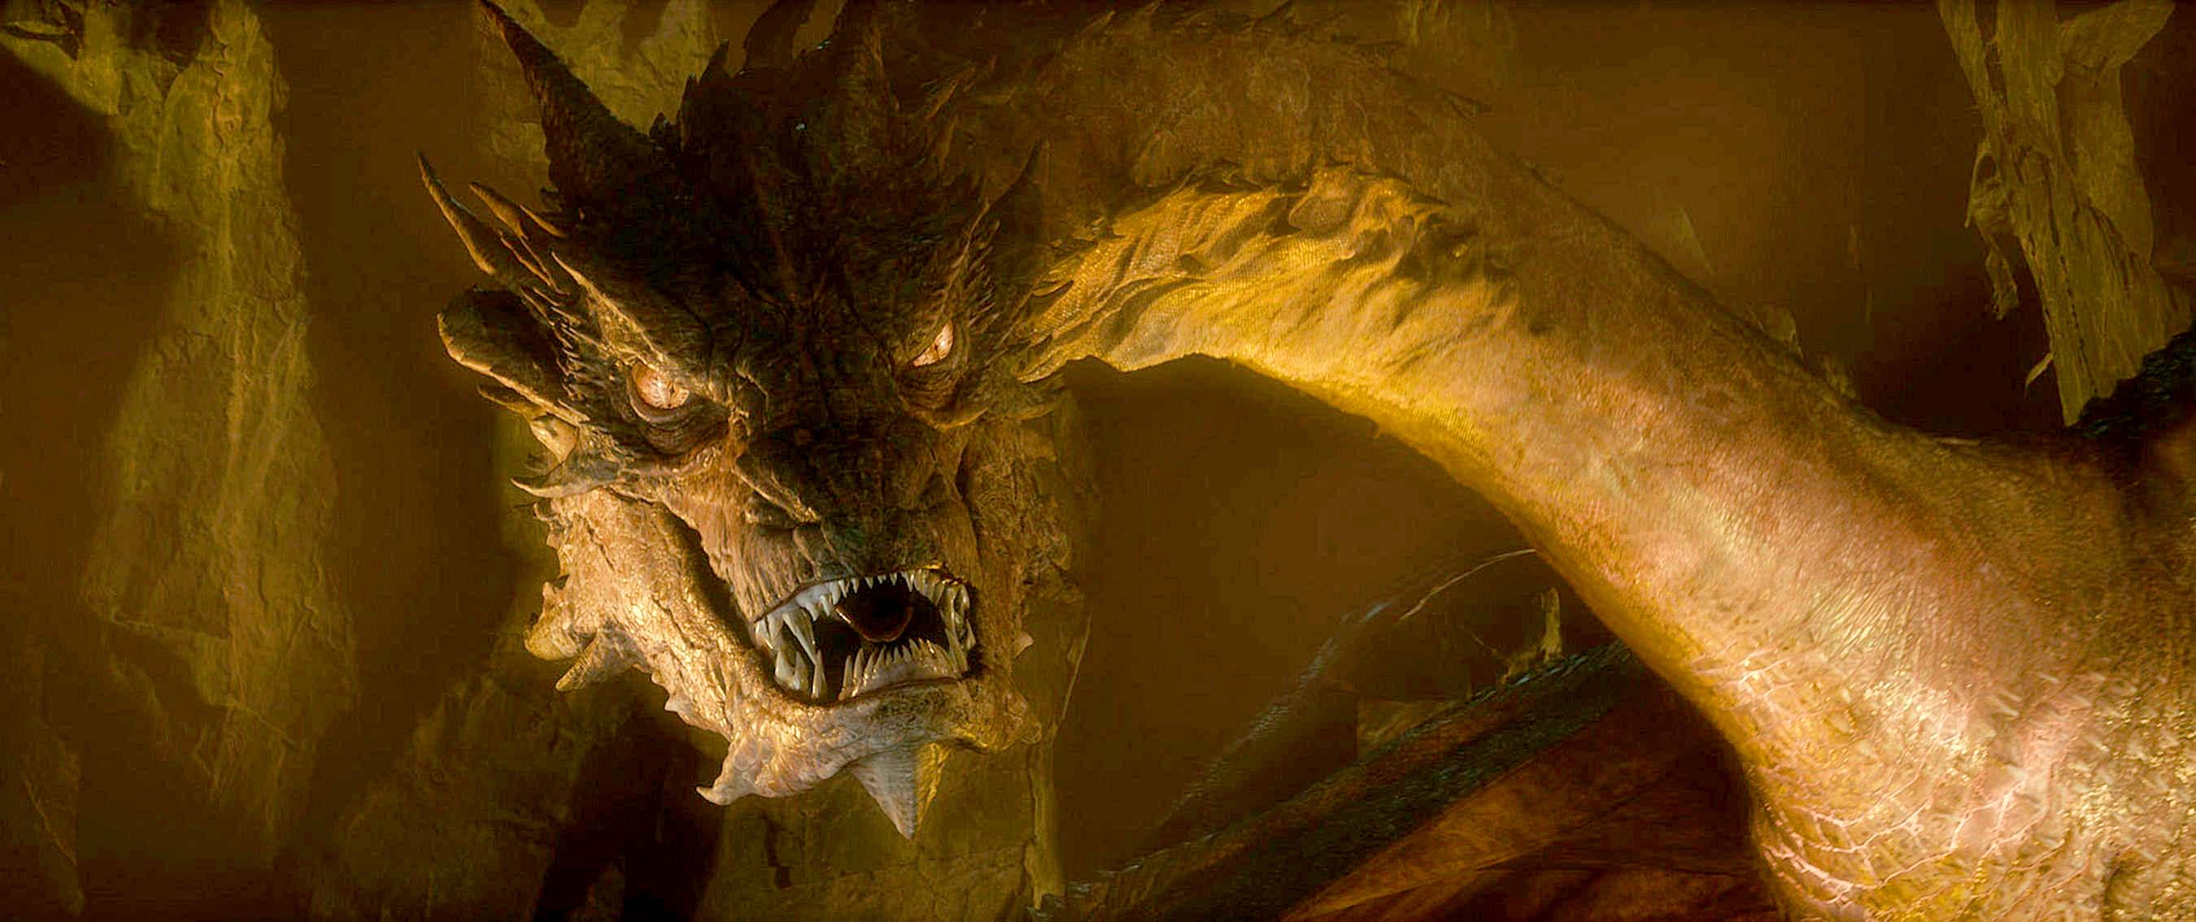
By Weta Digital
© 20th Century Fox

Slide 9
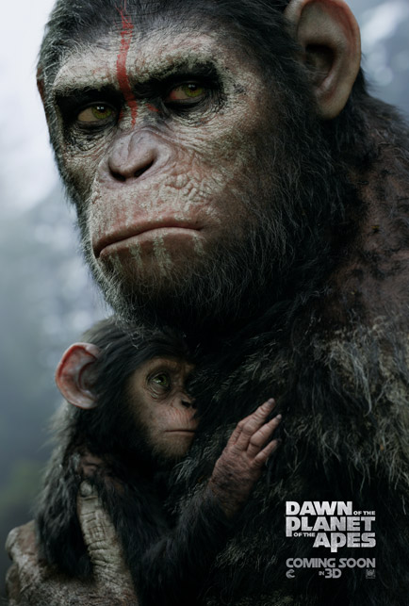
By Weta Digital
© 20th Century Fox

Slide 10
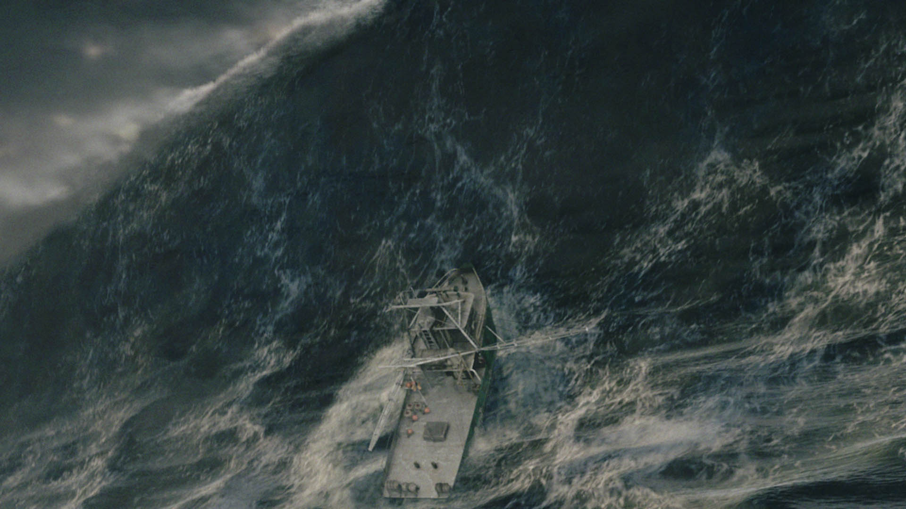
© 2000, IL&M

Slide 11
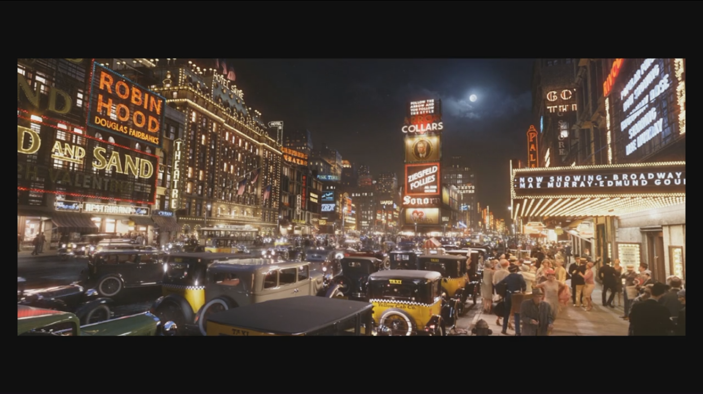

Slide 12
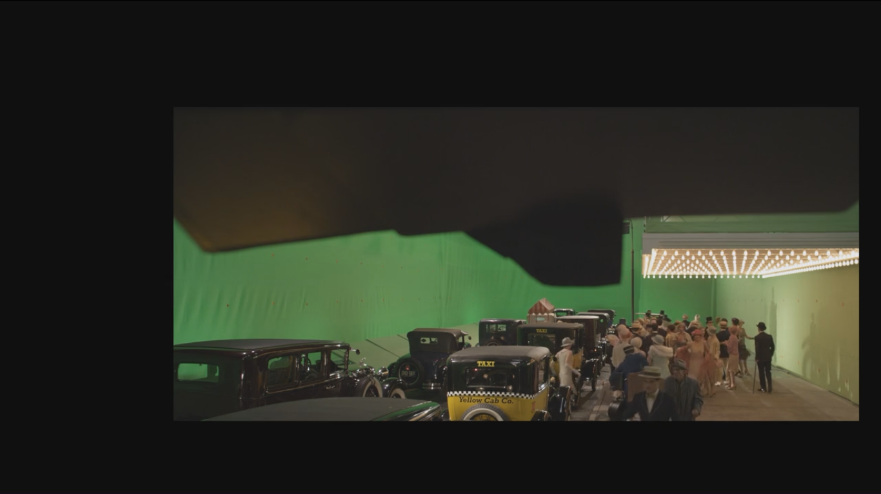

Slide 13
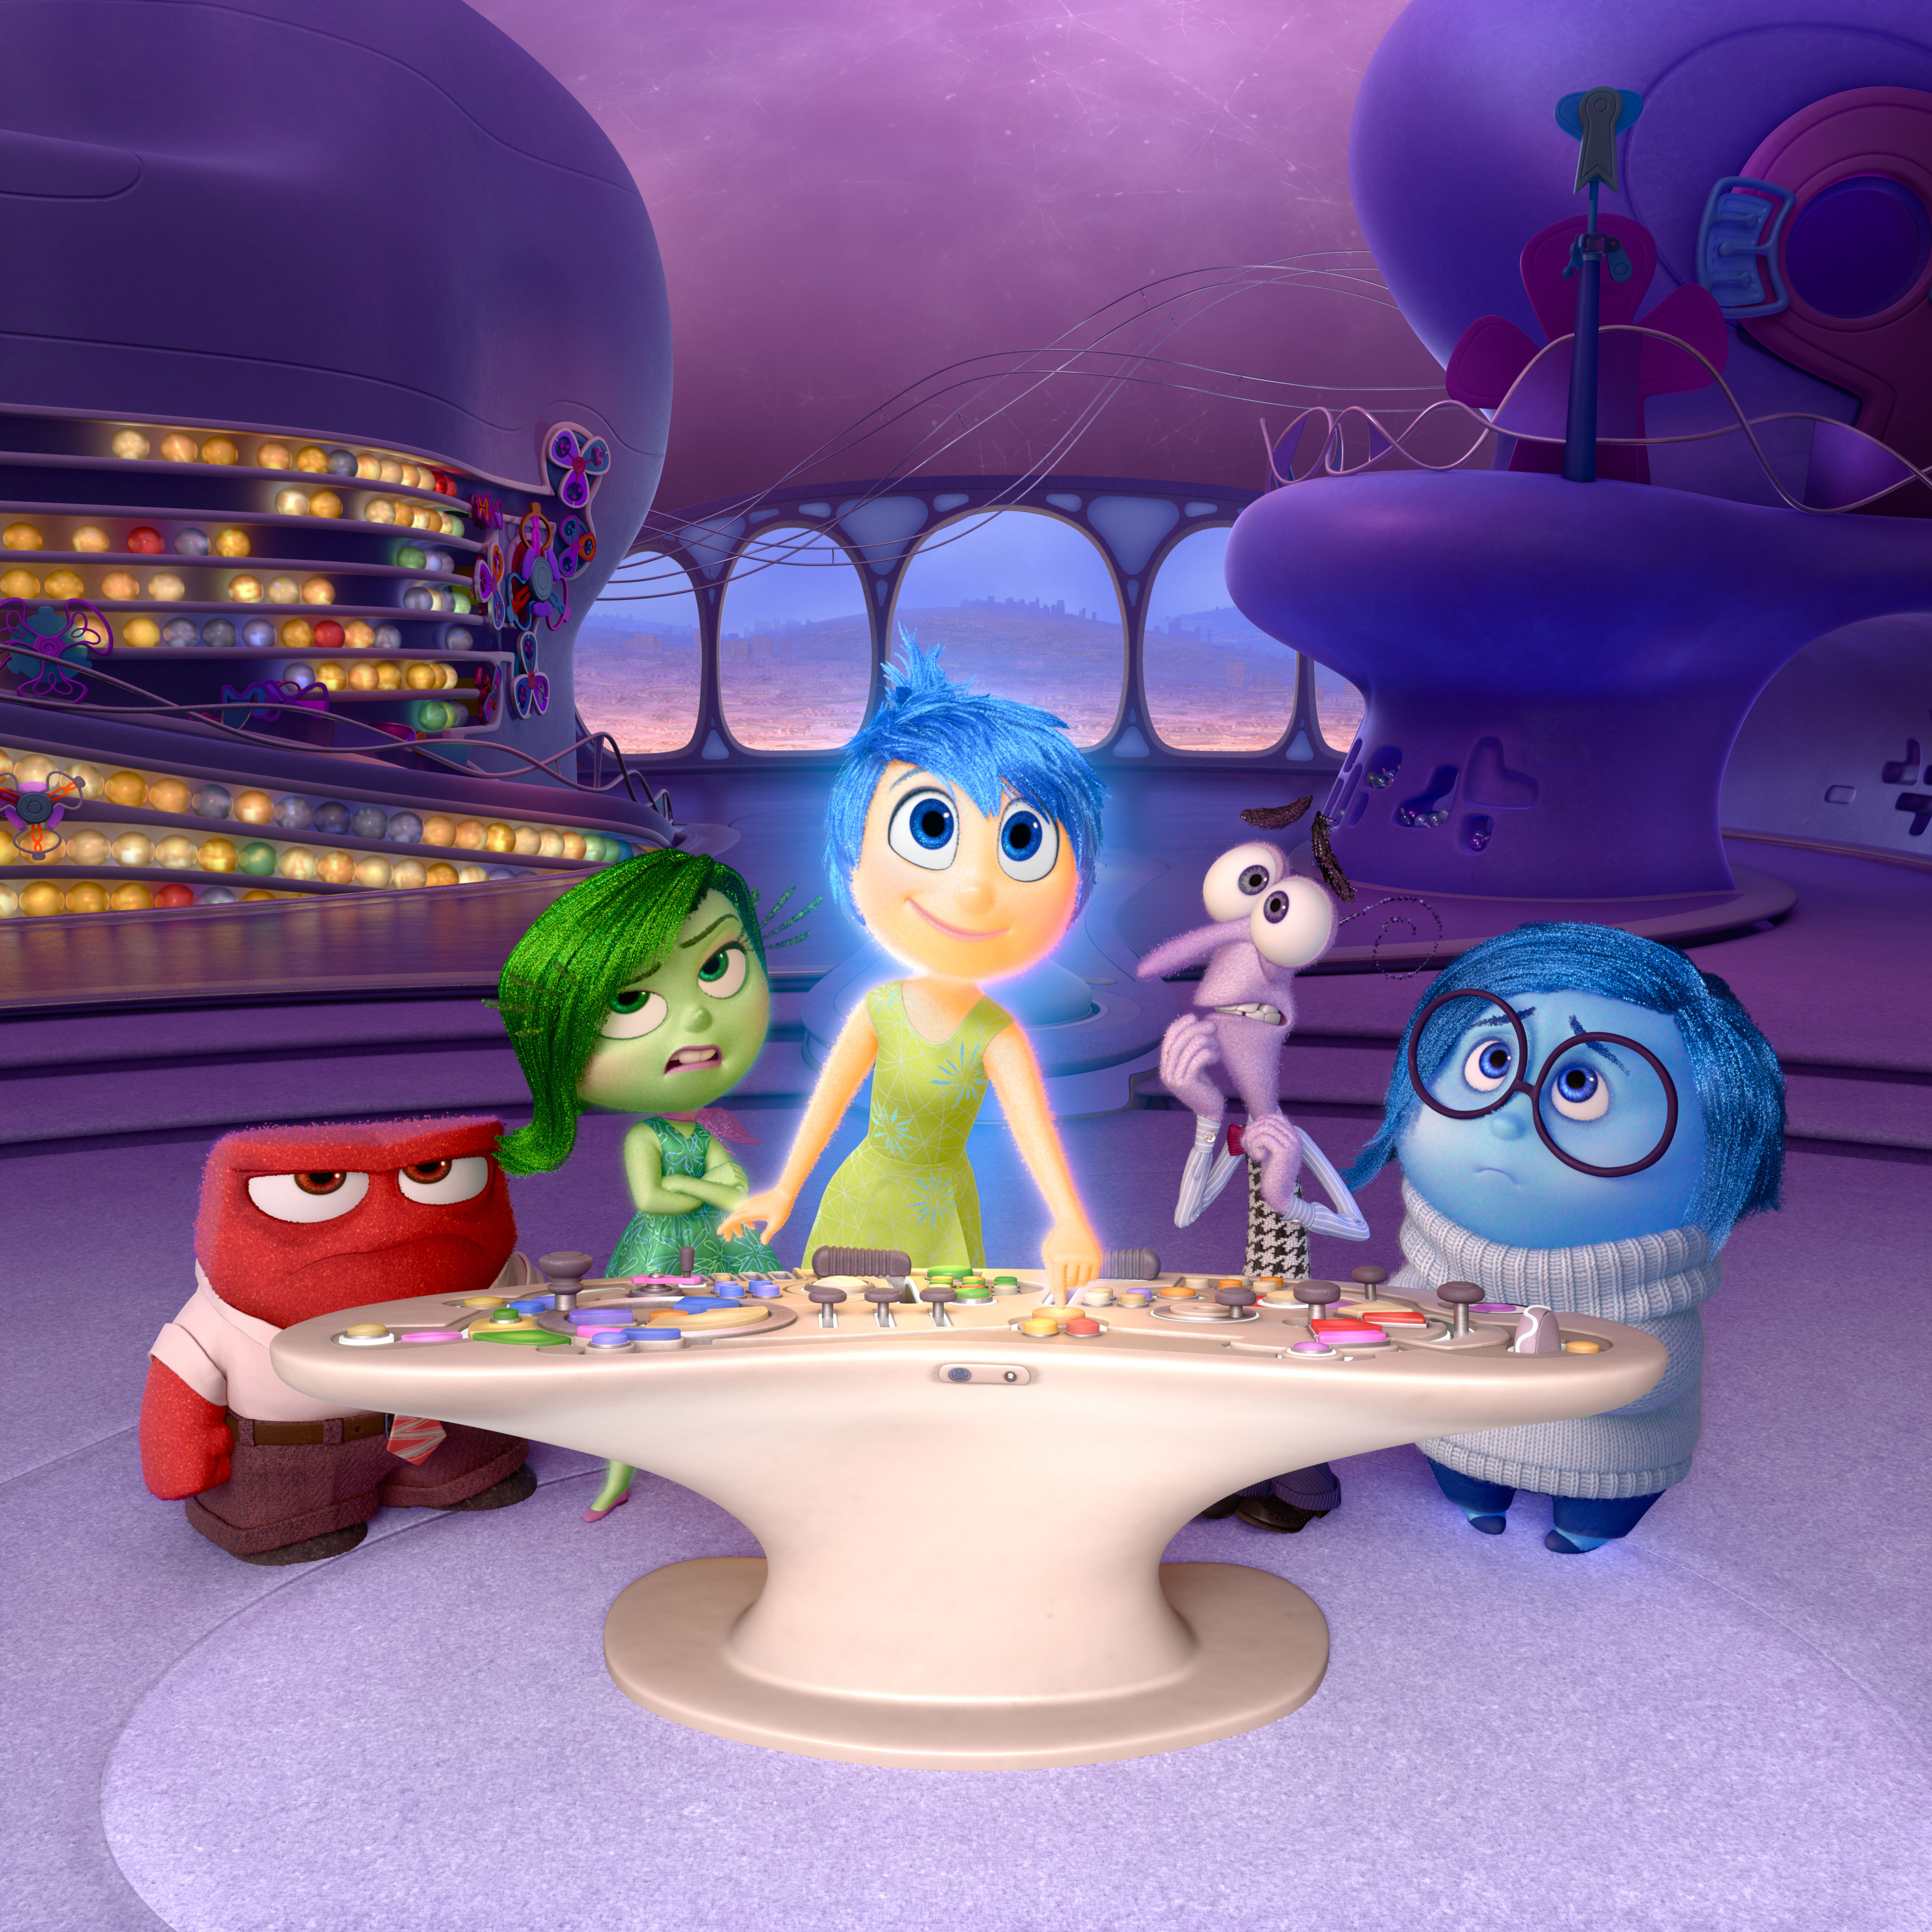
© 2015, Pixar Animation Studios, Walt Disney Pictures

Slide 14
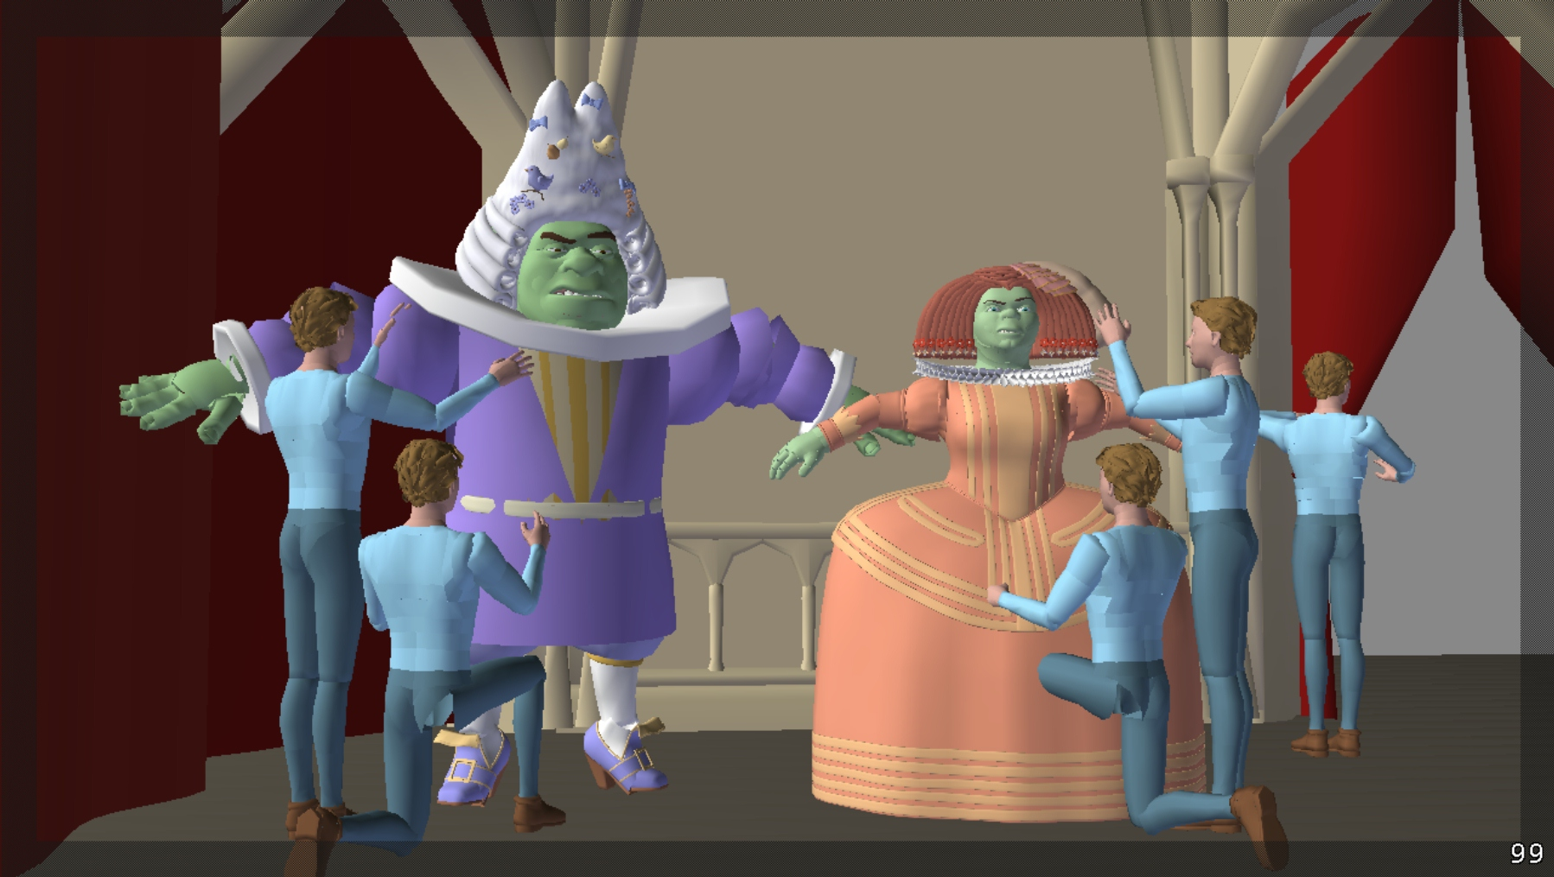
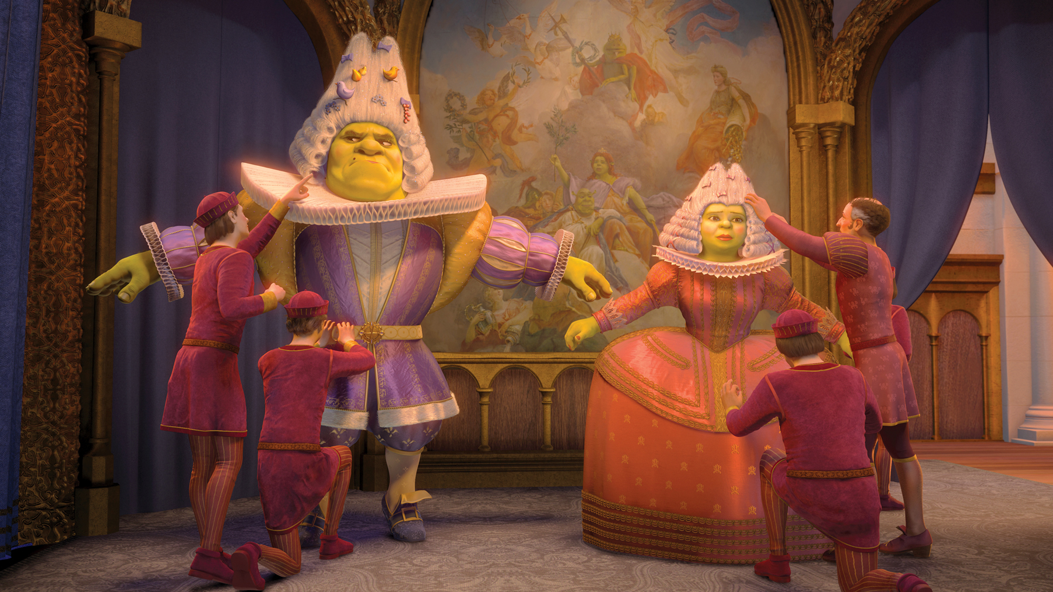
© 2007, DreamWorks Animation SKG

Slide 15

Realistic 3D graphics
3D scene modeling
  3DS Max, Blender, Rhino / CaptureReality
Object appearance
  Light reflectance models, textures, wear&tear
Animation
  Manual (character rigging, animation curves, ….)
  Physics based (rigid body, water simulation, explosions, …)
  Captured (mocap)
Lighting & rendering
  primary light sources + global illumination
  (GI) -> light transport simulation
Video compositing and compression
Image display (HDR imaging)

Slide 16
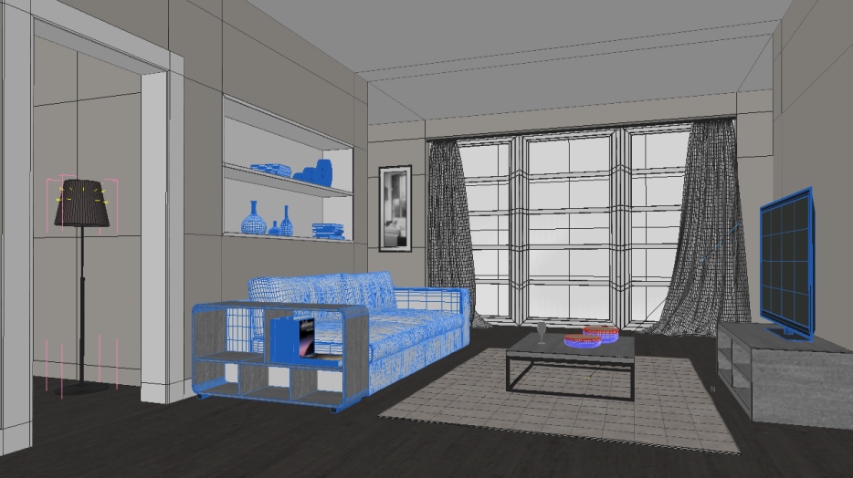
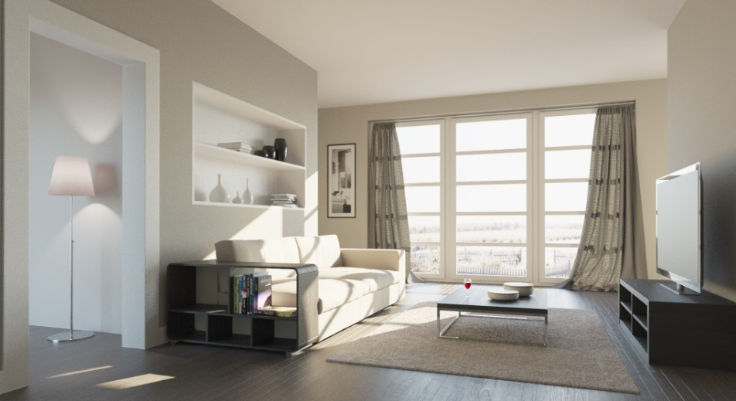
Rendering = (forward) light simulation
3D scene
Image

Slide 17






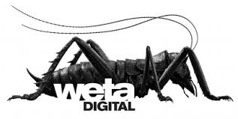


Notes:
By now, a wide range of existing commercial solutions based on ray tracing are available, with the pioneers still keeping their leading positions
V-ray continues to be the leader in archiviz
And Arnold is still the leader in VFX
Mental ray used to be strong but it’s become more of a legacy by now
As for archviz, numerous alternatives to V-ray are available, among which our Corona plays an important role.
In the VFX, PIXAR is trying to revamp their RenderMan
Some large production studios are building their own rendering solution
Weta digital (the makers of The Lord of the Rings or Avatar) have their Manuka renderer.
Don’t ask me why they decided to call it that way
But it’s not that hard to guess why the rendering developers of Disney Animation studios decided to call their baby Hyperion

Slide 18

Light simulation

Slide 19
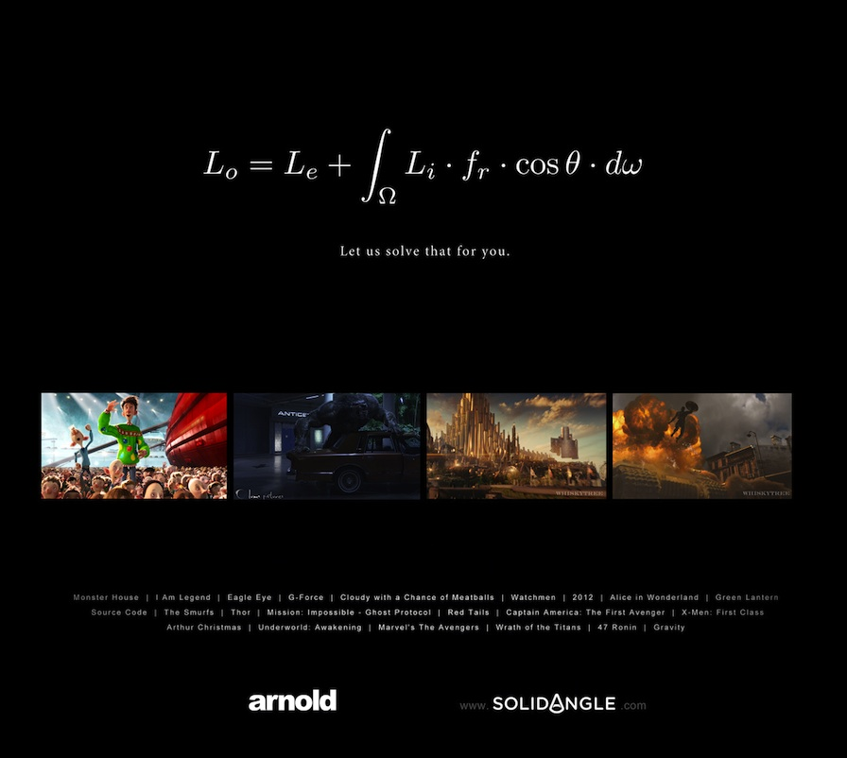

Slide 20
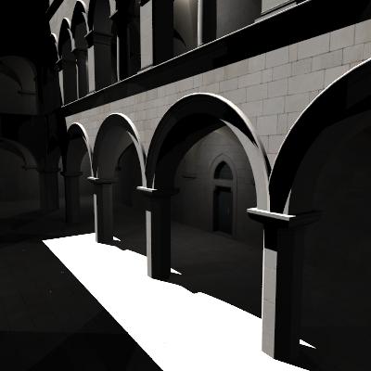
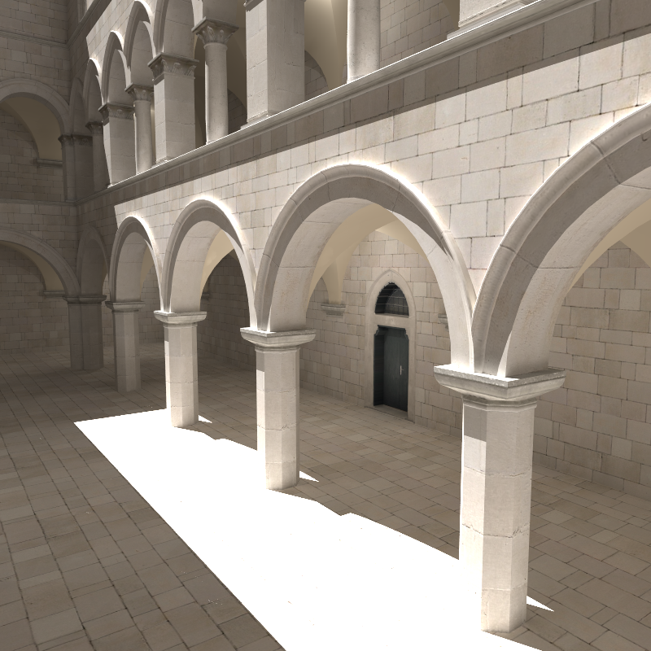
Global illumination – GI
Direct illumination
Global =
direct +
indirect
20

Slide 21
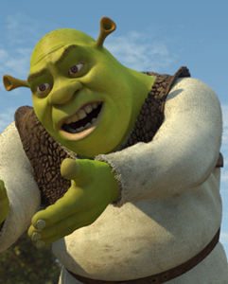
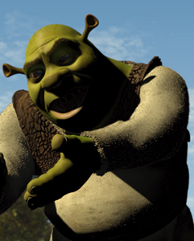
Global illumination – GI
Direct illumination
  Light reflects only once on its way from the source to the camera
Global illumination
  Global = Direct + Indirect
  Light transport between surfaces in the scene
Images © PDI/Dreamworks

Slide 22
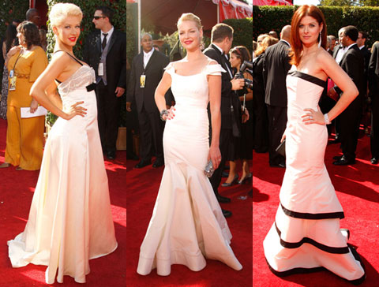
Global illumination – Color bleeding
Image courtesy Michael Bunnell
22

Slide 23
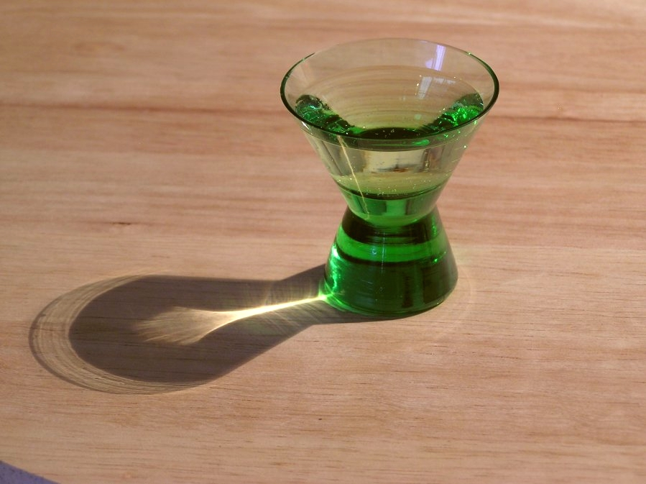
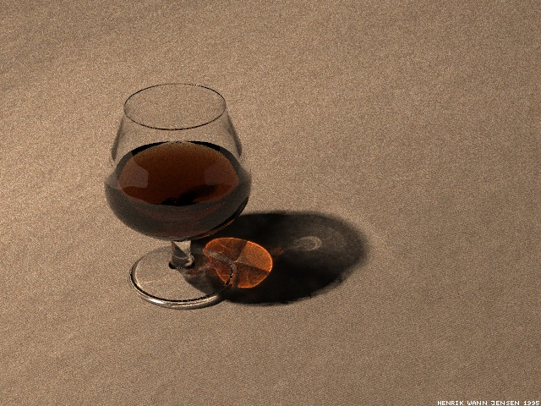
Global illumination – Caustics
Focusing of light as it’s reflected or refracted, leading to local increase of intensity
Photograph
Simulation using photon maps

Slide 24
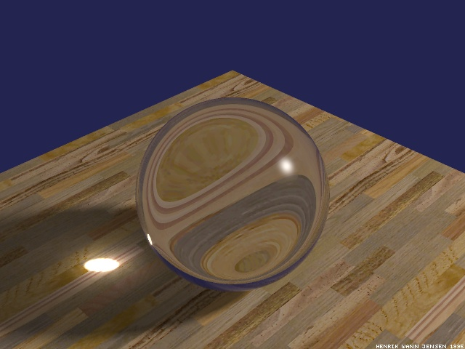
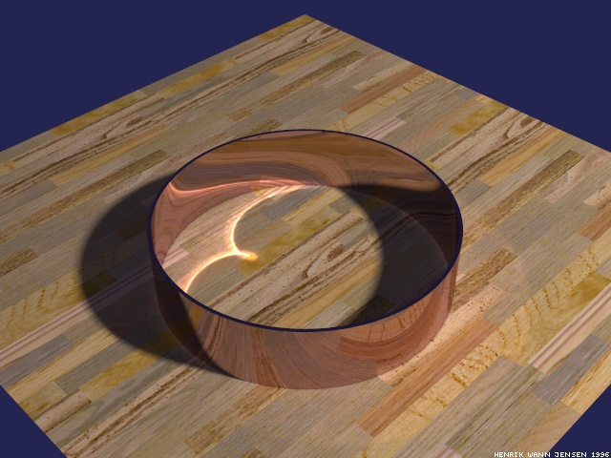
Caustics
In physics or in computer vision, a caustic refers to a singularity of light intensity (infinite density of light energy)

Slide 25
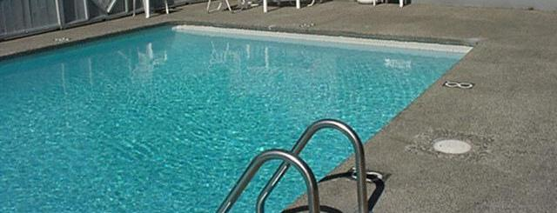
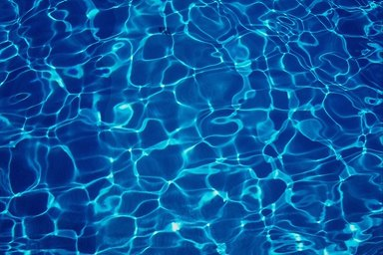
Global illumination – Caustics
Reflections + refractions on
water surface
Caustics at the bottom

Slide 26
Caustics under water surface
High „concentration“ of photons – high light intensity
Low intensity

Slide 27
We collaborate with…

Slide 28
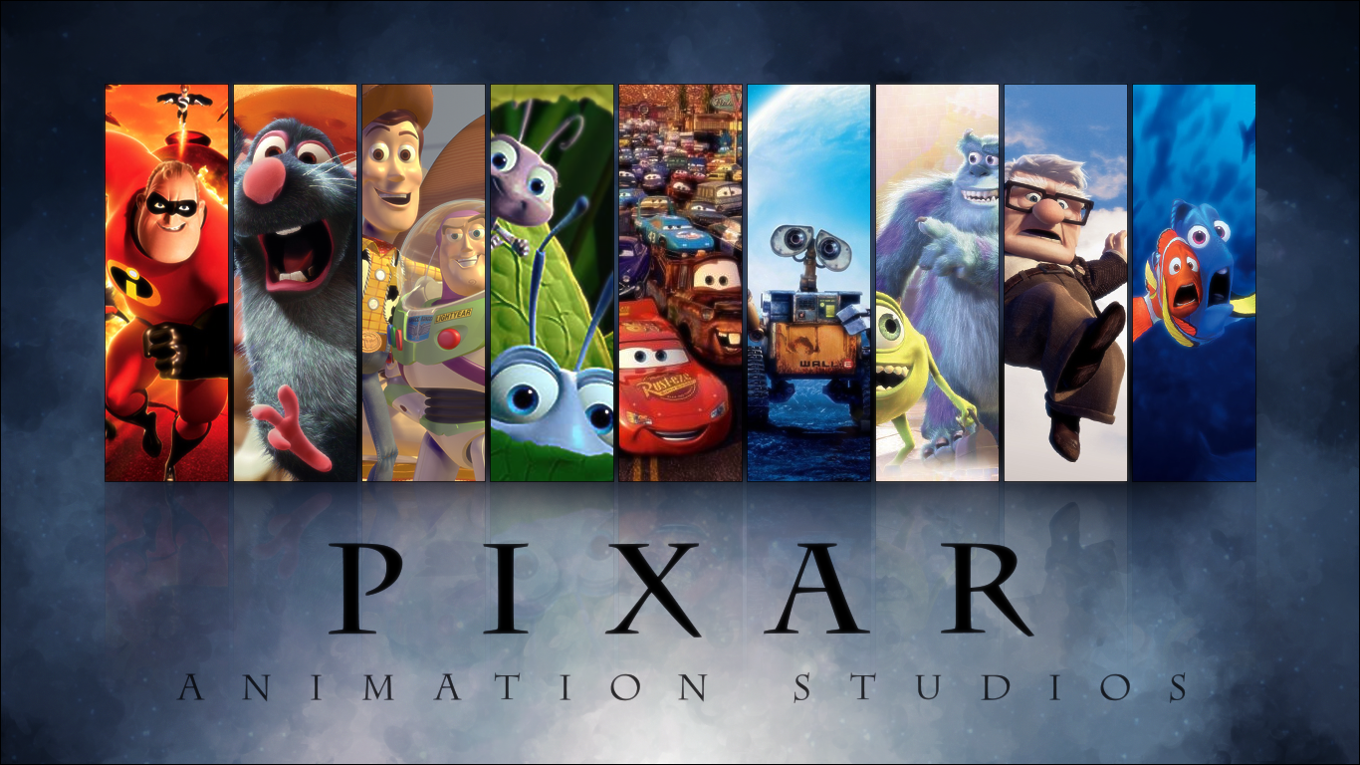
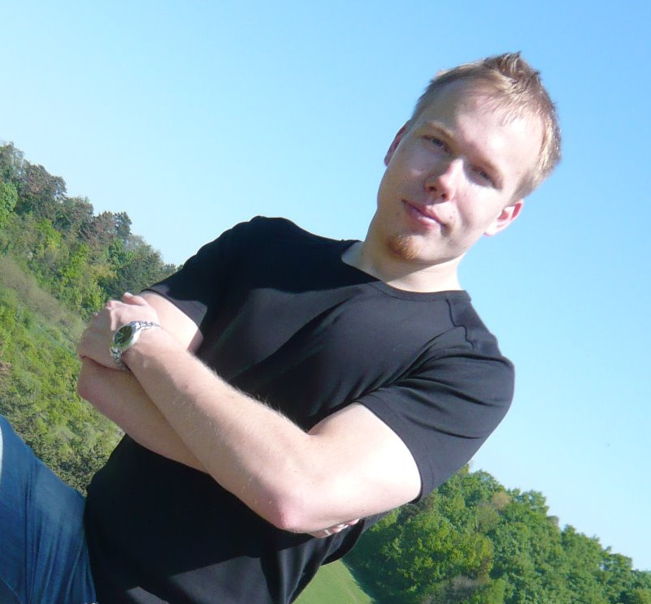

Slide 29
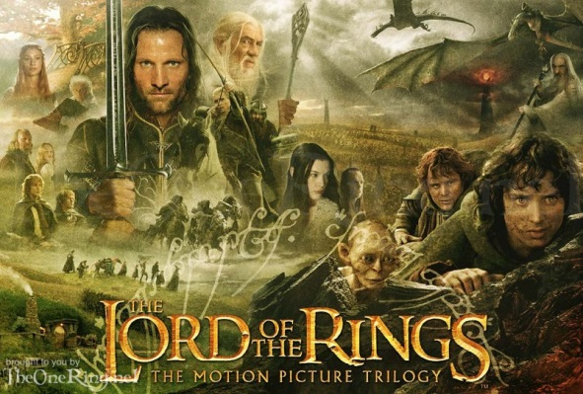
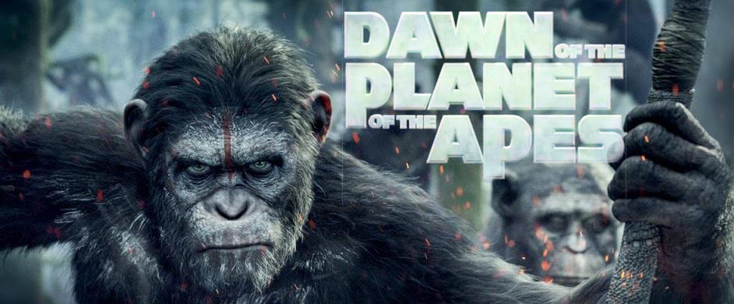

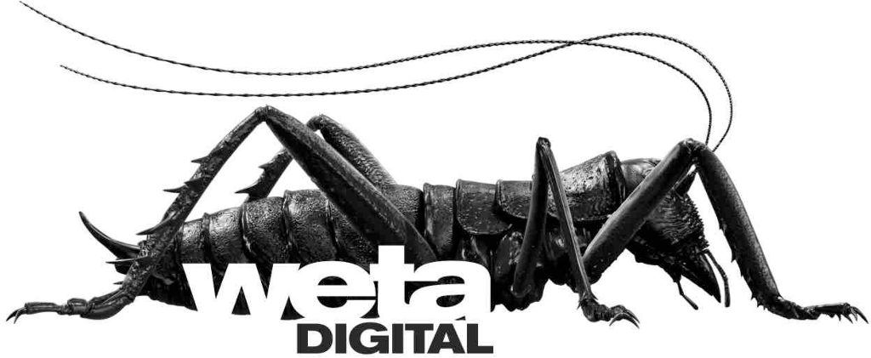


Slide 30


Other interesting (local) companies…

Slide 31
Realistic image synthesis: Ingredients
Describe the “amount of light” in space – radiometry
Describe light interaction with surfaces – BRDF
Describe equilibrium light distribution – rendering equation (RE)
Image rendering = numerical solution of the RE
  Find the equilibrium light distribution in a 3D scene
  Methods
    Finite elements (radiosity) – obsolete
    Monte Carlo (stochastic ray tracing) – prevalent

Slide 32
Example of our rendering research:
Smart(er) subsurface scattering
Křivánek and d’Eon. A Zero-Variance-Based Sampling Scheme for Monte Carlo Subsurface Scattering, ACM SIGGRAPH Talks 2014.

Slide 33
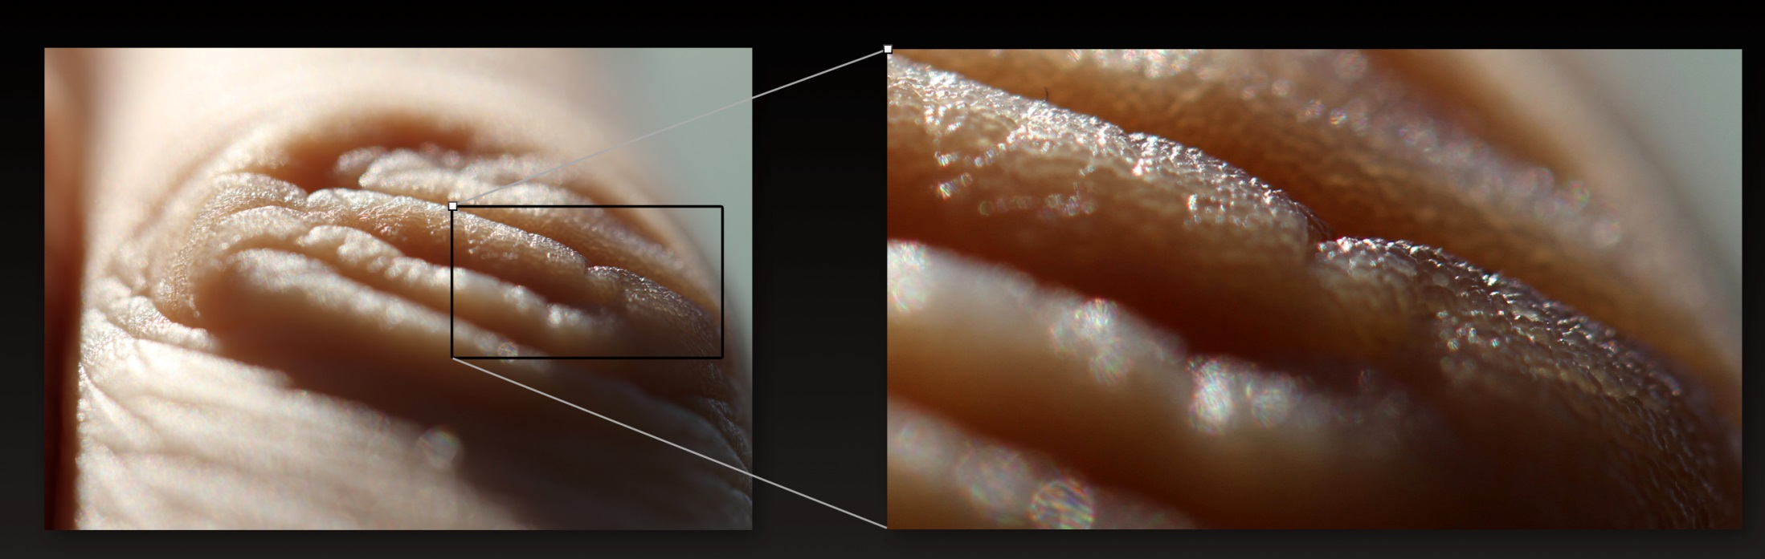

Slide 35
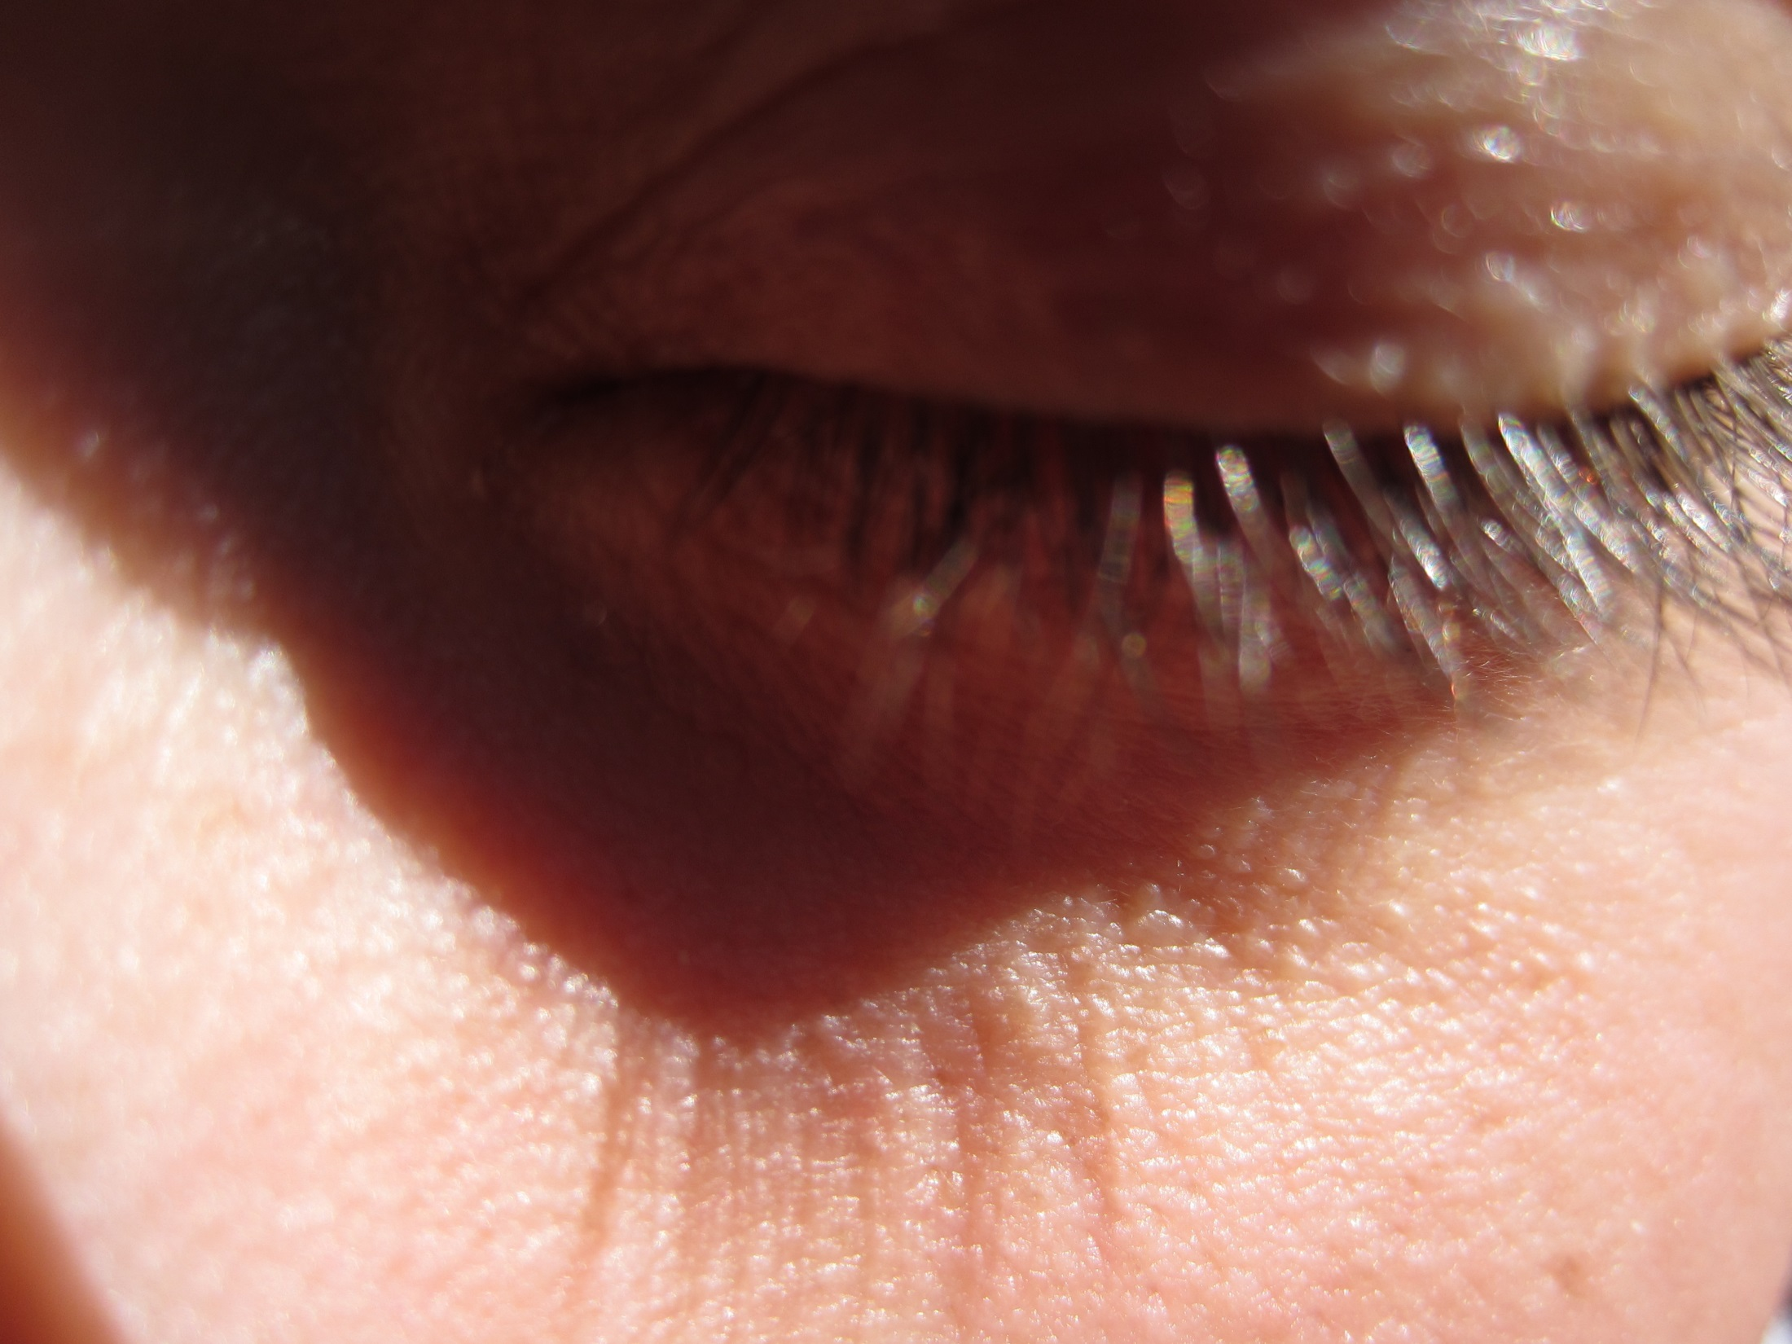

Slide 36
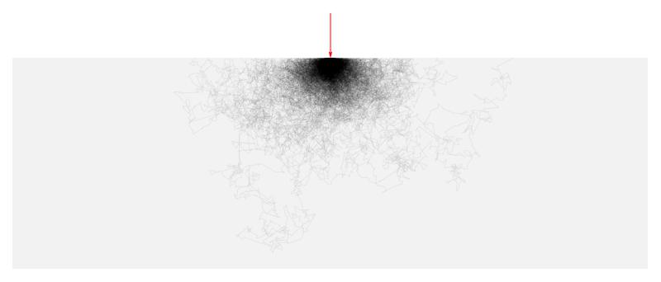
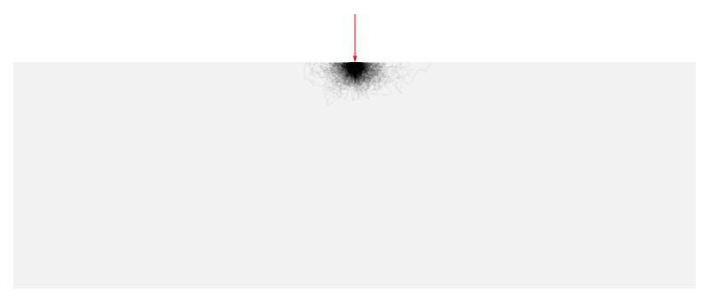
Light simulation under the surface
Classical random walk
  Oblivious to the boundary
Goal
  Guide paths toward the
  boundary

Slide 37
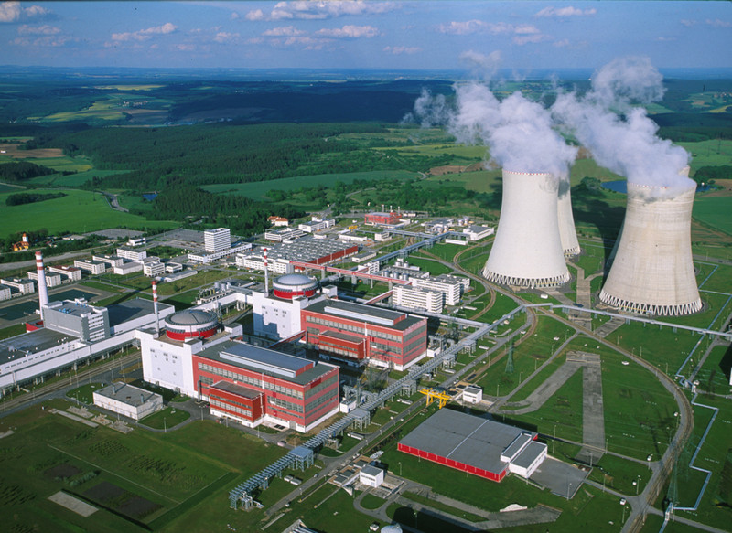

Slide 38
Previous work in neutron transport
Reactor shield design
  One in a billion particles makes it through
transmitted
radiation
incident
radiation
slab
(reactor shield)
Notes:
The so called “deep penetration problems” used in reactor shield design are particularly closely related.
By design, only a tiny fraction of the incident radiation is allowed to pass through a reactor shield.
For example, in a blind MC simulation only one in a billion particles would make it through, which makes the classic MC simulation totally hopeless.

Slide 39
Previous work in neutron transport
Path stretching [Clark ’66, Ponti ‘71, Spanier ‘71]
transmitted
radiation
incident
radiation
long step
short step
Notes:
One of the approaches to solve this issue is the so-called “path stretching”.
The idea is to advance the particles toward the outside by artificially stretching the sampled distance whenever the particle in a MC simulation points toward the exterior, and to shrink it when the particle is directed to the interior. To compensate for this, one needs to adjust the weight of the particle, because its behavior no longer follows the laws of physics.
Path stretching has originally been derived heuristically and relied on an ad-hoc parameter (the ‘strength’ of the stretching). While it often worked great, it could actually deteriorate the result (increase variance) when the stretching parameter wasn’t set judiciously.

Slide 40
Zero-variance random walk theory
Zero variance random walk theory
[Kahn ‘54, Kalos and Whitlock ’08, Hoogenboom ’08, Booth ‘11]
[Dwivedi ‘81]
  Synergistic path stretching and angular sampling
  Solid theory, no heuristics
Notes:
This is where the theory of zero-variance random walks comes into play.
The idea that a random walk can be constructed in such a way that it always yields the correct answer with absolutely no variance has been around for almost as long as MC methods themselves.
Despite the zero variance theory being old, Hoogenboom's recent 2008 NSE article (Zero-variance Monte Carlo Schemes Revisited) is very important: he corrects some misconceptions about the uniqueness of zero-variance walk construction that have lingered for several decades, and includes discussions about boundary crossing and track-length estimators as well.
Booth’s 2012 article (Common misconceptions in Monte Carlo particle transport) further clarifies and generalizes some of the concepts of zero-variance schemes. He argues that Hoogenbooms’ conclusion concerning the uniqueness of the zero-variance construstions are not correct and that there are multiple ways in which a zero-variance walk can be constructed.
Dwivedi [1981] was the first to apply the theory of zero-variance random walks to deep penetration problems.
He has shown how the heuristic path stretching automatically follows from the theory, while giving a clear answer to the parameter setting.
He was also the first to show that to robustly reduce variance, the path stretching needs to be combined with an appropriate angular sampling.
While he conceived his work with reactor shield design problems in mind, we apply his ideas to subsurface light transport and make further improvements.

Slide 41
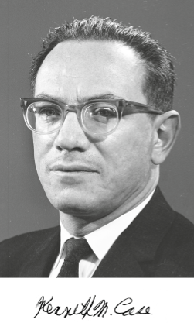
Analytical radiance solution
Case’s singular eigenfunctions
[Case 1960, McCormick and Kuscer 1973]
Singular eigenfunctions
transient terms
asymptotic terms
Notes:
In order to be able to build upon the zero-variance theory in constructing the random walk, we need an approximation of the radiance solution under the surface.
Note that the Monte Carlo estimator that we construct is unbiased irrespective of the accuracy of this approximate solution; the accuracy only affects the variance reduction but not the unbiasedness of the resulting estimator.
For this reason, we choose to approximate the true sub-surface distribution of radiance using a solution for a half-space with flat boundary.
In this setting, the phase space position r can be specified by the (optical) depth under the surface, x, and the direction cosine υ.
The exact half-space solutions that we use can be derived in several ways, including what is known as Caseology, named after Kenneth Case who was on the theoretical division at Los Alamos building the first bombs. In 1960 Case studied in detail the 'spectrum' of the transport operator in the plane-parallel case, and derived an expansion into the discrete asymptotic diffusion mode, and the continuous spectrum of 'singular eigenfunctions' - so named because the angular distributions (the phi-functions on the slide) for the transient terms are singular. This study of the structure of exact solutions in transport is incredibly insightful and we are the first, to our knowledge, to exploit it directly in a rendering technique.
Each eigenfunction of the spectrum has the same form: the spatial term that only depends on the depth under the surface is a simple exponential, with different eigenfunctions having different decay rates. The angular term then corresponds to integrating the spatial term along a line from a given depth in a given direction.

Slide 42
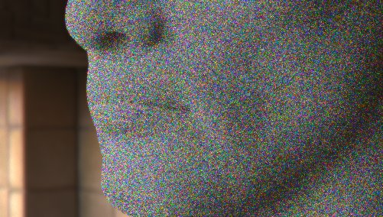

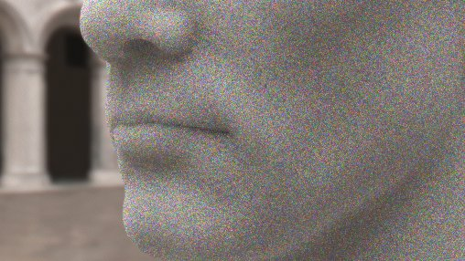
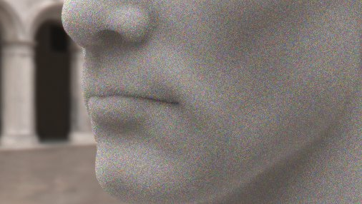
Use in rendering
MIS: 75% Dwivedi sampling + 25% “analog” sampling
equal-time comparison, 100 samples per pixel
classical sampling
our result
classical sampling
our result
Notes:
Despite the fact that the importance function driving the sampling assumes uniform hemispherical illumination, the modified path sampling lowers variance even when the illumination is nonuniform.
The images rendered with classical sampling use 100 samples/pixel while in our results we trace about 50% more samples/pixel in the same time.
While the speedup is a profitable side-effect, most of the variance reduction is due to the sampling pdfs closely approximating the zero-variance sampling scheme.
As on the previous slide, the subsurface medium has a single scattering albedo of 0.943 for all wavelengths and index-matched smooth boundaries.
The individual rows show results for different environment maps.

Slide 43

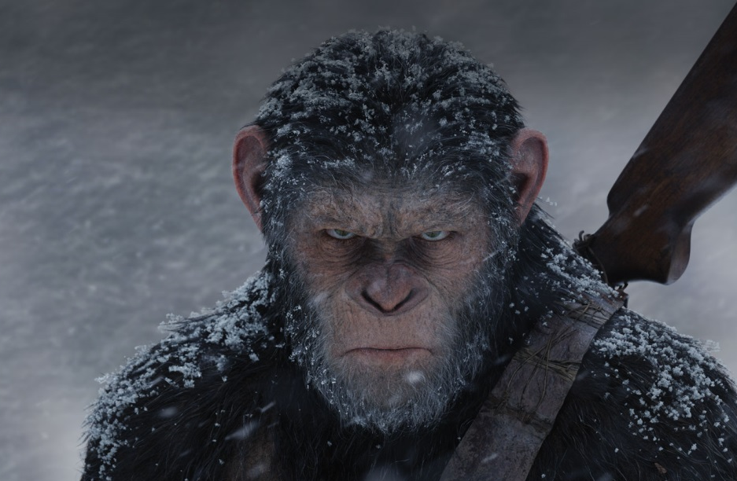




Slide 44
3D PRINTING & APPEARANCE FABRICATION

Slide 45
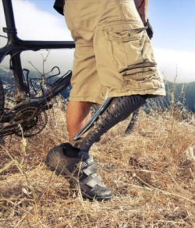
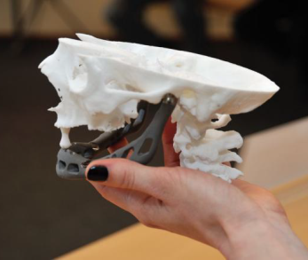
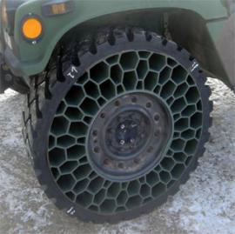
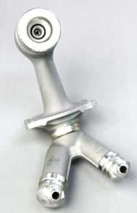
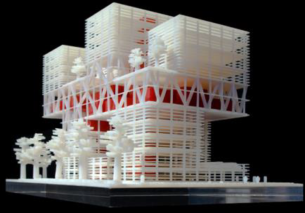
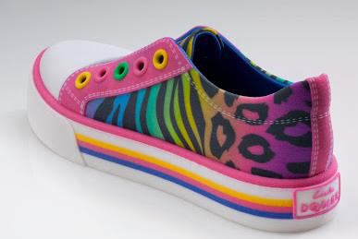
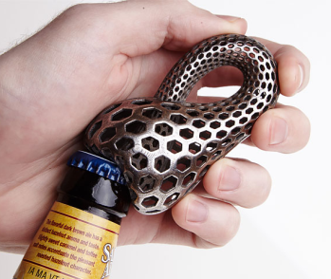
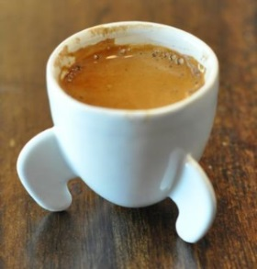




3D printing
prosthetics
auto & aero
prototyping
utility items
learning
fashion & art

Slide 46


3D printing – FDM
© 2016, Prusa Research

Slide 47


3D printing
3D model
  CSG, triangle-mesh, …
  STL format
Rasterization into a volume
  “Slicer” software
  similar to 2D rasterization
  Design of support materials
Geometric optimization
  Structural integrity, balance
  Stiffness simulation
Appearance optimization
  Color, transparency, roughness, …

Slide 48

Multi-colored 3D prints
Stratasys J750 full color

Slide 49


Slide 50


Slide 51


Does the 3D printed sushi look like real sushi?

Slide 52
New problem: “Realistic appearance fabrication”

Slide 53

Appearance fabrication
?
Target
Some sort of
processing
Visual match

Slide 54
Example of our 3D printing research:
SCATTERING-AWARE TEXTRURE REPRODUCTION IN 3D PRINTING

Slide 55
Textured 3D prints

Slide 56
Translucency blurs textures
Target
Default print

Slide 57

Precorrection for optical aberrations

Slide 58

3D print is not just a flat image

Slide 59

Iterative precorrection process
Target

Slide 60
Appearance fabrication
?
Target
Some sort of
processing
Visual match

Slide 61
Appearance fabrication
Target
Our
iterative
precorrection
Visual match

Slide 62
More results
Target
Default print
Our result

Slide 63
More results
Target
Default print
Our result

Slide 64

What’s next?
https://www.mcae.cz/cs/student-brnenskeho-vut-navrhl-vyrobil-proteticke-oko-3d-tiskarne/

Slide 65

What’s next?

Slide 66


Slide 67

CGG BBQ

Slide 68



Slide 69


Slide 70


Slide 71

Khronos Prague Meetup

Slide 72
Events
CGB = Computer graphics beer
  Roughly once a month in a pub in Prague
CGBBQ = Computer graphics barbeque
  Once a year in May
CG seminar
HiVisComp
  Every winter (includes sking), gathering of computer graphics enthusiasts from Czech Republic, Slovakia and elsewhere
  http://www.hiviscomp.cz/
CESCG
  Student research
  Slovakia, Austria, Czech rep., Hungary, DE, FR, apod.
  http://www.hiviscomp.cz/

Slide 73
Light

Slide 74
Different approaches to rendering
Phenomenological
  Traditional, “old” computer graphics
  E.g. Phong shading model, colors between 0 and 1, etc.
Physically-based
  Based on a proper mathematical formulation
  Rendering algorithms = numerical methods for solving the rendering equation
  Radiance values between 0 and infinity

Slide 75
Mathematical model
Image synthesis (rendering) = light transport simulation
We need a mathematical model for light
Formulation of the model = choice of level of detail
  No need to model the behavior of every single photon
  Need simplifying assumptions

Slide 76

Light
EM radiation (an EM wave propagating through space)
Image: Wikipedia

Slide 77

Light
Frequency of oscillations => wavelength => perceived color
Image: Wikipedia

Slide 78
Various kinds of optics
Geometry (ray) optics
  Most useful for rendering
  Describes bulk, macroscopic effects of light
  It is not a complete theory (Does not describe all observed phenomena, such as diffraction, interference etc.)
Wave optics (light = E-M wave)
  Important when describing interaction of light with objects of size on par with the light wavelength
  Interference (soap bubbles), diffraction, dispersion
Quantum optics (light = photons)
  Necessary to describe interaction of light with atoms

Slide 79

Effects of the wave nature of light
Interference
  Causes iridescence (structural coloration)
Constructive
Destructive
Img: Wikipedia

Slide 80


Iridescence
Thin-film interference
Color changes with the observation angle
Img: http://en.wikipedia.org/wiki/Iridescence

Slide 81

Iridescence – Structural coloration
Biological tissues can have layers causing interferences
Img: http://en.wikipedia.org/wiki/Iridescence

Slide 82

Iridescence – Structural coloration
Img: http://en.wikipedia.org/wiki/Iridescence

Slide 83

Iridescence – Structural coloration
Img: http://en.wikipedia.org/wiki/Iridescence

Slide 84

Polarization
Preferential orientation of the E-M waves with respect to the direction of travel
Unpolarized light – many waves with different polarization
More in the “Predictive
rendering” class

Slide 85


Polarization
Skylight is partially polarized
Specular reflections are polarized

Slide 86
Thank you!
cgg.mff.cuni.cz/~jaroslav

